Slide 1
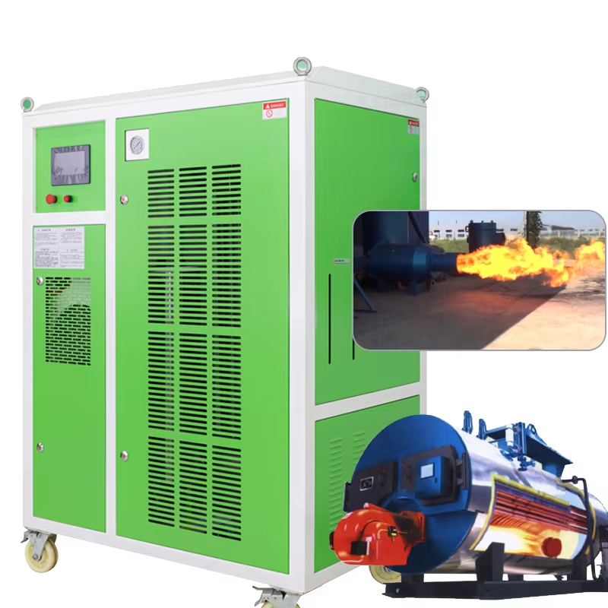
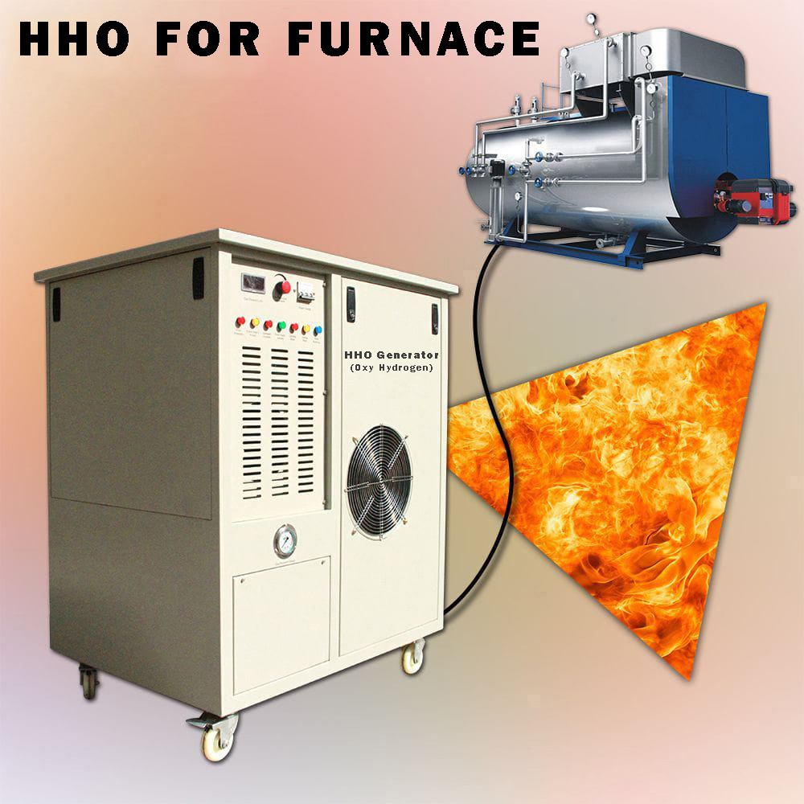
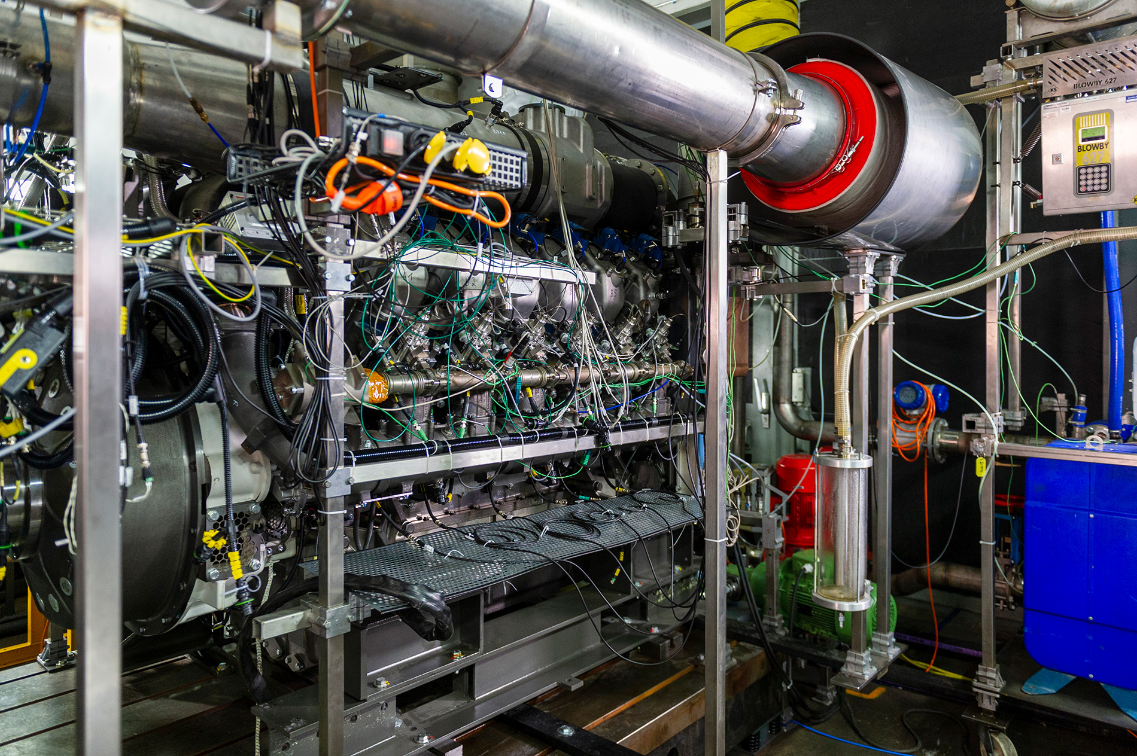
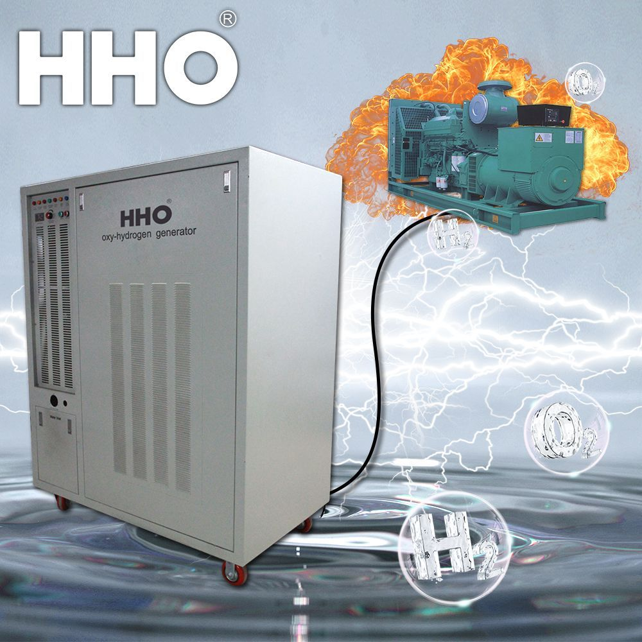
HHO Generator (Oxyhydrogen)
for
Boiler, Furnace, Engines & DG set
HHO generator increases fuel efficiency saves money also improve the combustion process.
Reduces harmful emissions enhancing overall engine performance and lifespan
Boiler Furnace Engine DG set
" Money Savings With Clean & Efficient Energy Solutions "

Slide 2
Introduction
What is an HHO Generator
An HHO Generator is a device that uses electrolysis to split water (H₂O) into hydrogen (H₂) and oxygen (O₂) gases, often called Green Gas.
The generated gas is then introduced into an internal combustion engine or other heating systems, through gas burner where it mixes with the regular fuel. This results in:
Power Source
Fuel Source
Output
Runs on electricity.
Distilled water or R.O Water.
Live flammable Hydrogen gas.
use as a Co - Fuel (No Storage)
It’s seen as a clean-energy booster because the only emission from burning HHO itself is water vapor.
Basic definition: A device that uses electrolysis to split water into hydrogen and oxygen gas for fuel enhancement.

Slide 3

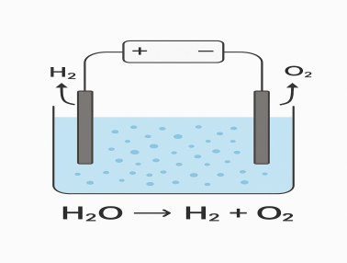
Working Principle
Enhancing Combustion Efficiency
Explanation: How HHO gases are fed in to improve combustion efficiency.
01
02
Gas Production
Engines Mixing with Intake Air
The HHO generator produces a mixture of hydrogen and oxygen gases from water via electrolysis. The gas is immediately directed into the engine’s air intake system.
HHO gas blends with the incoming air-fuel mixture before entering the combustion chamber. Hydrogen is highly flammable and burns at a faster rate than gasoline or diesel hence saves fuel.
03
Enhanced Combustion in Boiler
Hydrogen gas burner works as a secondary co heating instrument in boiler and heat instruments more completely and evenly. This reduces main fuel requirement.

Slide 4




Key Benefits of HHO Generator
Fuel Savings
Cost-Effective
Reduces fuel consumption by improving combustion efficiency, leading to 15% to 20% savings.
Low maintenance and a long-lasting solution, ensuring significant savings over time.
Eco-Friendly
Engine Performance
Cuts down harmful exhaust gases, helping reduce carbon footprint and promoting cleaner air.
Provides smoother operation, lower emissions, more power, less carbon buildup, and increased engine efficiency.

Slide 5




HHO Generator Applications
Industrial Boilers,
Furnace& Generators
Automotive Fuel Saving
Optimizes combustion in boilers, industrial generators, power plants, and industrial heating systems.
Enhances fuel efficiency in automotive cars, trucks, and buses.
Diesal,Petorl Engines
Renewable Energy Setups
Improves performance and reduces emissions in marine engines.
Integrates with certain renewable energy systems for enhanced efficiency.

Slide 6
HHO Generator Safety Features
1
2
3
Flashback Arrestor
(Flame Arrestor)
Bubblers
Pressure Relief Valve
A small water-filled chamber between the generator and engine that acts as a flame trap and cools the gas.
Releases excess pressure if gas production exceeds safe limits, preventing damage or bursting.
Prevents any flame from traveling back from the engine into the generator, usually fitted on the gas output line.
4
5
6
Automatic Power Cut-off
Non-Return (Check) Valves
Leak-Proof Construction
Turns off the generator if the engine is not running, preventing unnecessary gas build-up.
Ensures gas flows in only one direction—towards the engine—preventing backflow.
Strong, sealed chambers from corrosion-resistant materials and quality seals prevent water or gas leakage.
7
Electrical Safety
Proper fuses and relays prevent overheating or short circuits, with insulated wiring to avoid hazards.

Slide 7
Case Studies / Results
Industrial Diesel Generator – 100 kVA DG set
Fuel Consumption (L/hr)
21.0
18.5 with HHO generator
12% savings
CO₂ Emissions (kg/hr)
57.8
49.5 with HHO generator
14.3% savings
Key Observations for DG SETS
Fuel savings typically range from 12–19 % depending on engine type and operating conditions.
Significant reduction in harmful emissions such as CO, NOx, and particulates.
Engines run smoother with less carbon buildup, leading to lower maintenance costs.
Emission reduction gives long life and low maintenance.
* This is an approximate estimation as per type of Boiler, capacity, fuel & fuel consumption the values may vary.

Slide 8
Case Studies & Results
HHO Generator on Different Fuel Boilers
Oil-Fired Boiler/Furnace
210 L/hr
186 L/hr
11.4%
Lower fuel use, cleaner flame, reduced CO₂
Coal-Fired Boiler /Furnace
950 kg/hr
850 kg/hr
10.5%
More complete combustion, less unburned coal in ash
Wood-Fired Boiler /Furnace
1,200 kg/hr
1,050 kg/hr
12.5%
Higher flame temperature, less smoke
Gas-Fired Boiler /Furnace
180 m³/hr
160 m³/hr
11.1%
Reduced gas usage, more stable burner operation
Key Observations for BOILER
Fuel Savings: 10–13% across all tested boiler types.
Emissions: Noticeable reduction in CO₂, CO, and particulate matter.
Combustion Efficiency: Flame burns hotter and cleaner with less soot buildup.
Maintenance: Reduced fouling on heat exchange surfaces, lowering cleaning frequency.
* This is an approximate estimation as per type of Boiler, capacity, fuel & fuel consumption the values may vary.

Slide 9
Cost & ROI Analysis of HHO Generator
1. Example System Setup
Application: As per requirement of the plant
HHO Generator Capacity: As per requirement of the plant
Purchase Cost: As per requirement of the plant
Installation Cost: As per requirement of the plant
Total Investment: As per requirement of the plant
2. Operating Cost
Electricity Use: 400W, costing ₹4–₹5 per hour (₹120/day for 24 hr)
Electrolyte & Maintenance: ₹2,000/month (minimal)
3. Fuel Savings Example
For an oil-fired boiler before & after HHO:
Before HHO: 210 L/hr fuel consumption
After HHO: 186 L/hr fuel consumption
Fuel Saved: 24 L/hr
4. ROI Calculation
Total Investment: As per requirement of the plant
Daily Savings: As per requirement of the plant
Payback Period: As per requirement of the plant
5. Notes
ROI varies depending on fuel type, operation hours, and HHO generator size.
For coal, wood, and gas systems, ROI can range from 1 to 1.5 Year.
After payback, the savings are pure profit.

Slide 10
Payback Period of HHO Generator via Fuel Savings
Example 1 – Oil-Fired Boiler
Fuel Price: ₹90/L
Fuel Saved: 24 L/hr
Daily Operation: 10 hrs/day
* Daily Savings: 24 × ₹80 = ₹2,160/hr → ₹21,600/day × 345 = 74,52,000/-
System Cost: As per requirement of the plant
Payback Period: 320 days (Aprox.)
Example 2 – Coal-Fired Boiler
Fuel Price: ₹10/kg
Fuel Saved: 100 kg/hr
Daily Operation: 10 hrs/day
* Daily Savings: 100 × ₹10 = ₹1,000/hr → ₹10,000/day × 345 = 34,50,000/-
System Cost: As per requirement of the plant
Sr. | Summary Table Fuel type | Payback Periods*
1 | Coal | 320 Days
2 | Wood | 328 Days
3 | Oil | 331 Days
4 | Gas | 334 Days
Payback Period: As per requirement of the plant
* This is an approximate estimation as per type of Boiler, capacity, fuel & fuel consumption the values may vary.

Slide 11
Example 3 – Wood-Fired Boiler
Fuel Price: ₹8/kg
Fuel Saved: 150 kg/hr
Daily Operation: 10 hrs/day
* Daily Savings: 150 × ₹8 = ₹1,200/hr → ₹12,000/day × 345 = 41,40,000/-
System Cost: As per requirement of the plant
Payback Period: As per requirement of the plant
Example 4 – Gas-Fired Boiler
Fuel Price: ₹55/m³
Fuel Saved: 20 m³/hr
Daily Operation: 10 hrs/day
* Daily Savings: 20 × ₹55 = ₹1,100/hr → ₹11,000/day × 345 = 37,95,000/-
Summary of Benefits – HHO Generator
· Fuel Savings: Reduces fuel consumption by 11–19 % across oil, coal, wood, and gas systems.
· Lower Emissions: Cuts CO₂, CO, NOx, and particulate matter for cleaner operation.
· Improved Combustion Efficiency: Hotter, cleaner flame with reduced soot and carbon deposits.
· Fast ROI: Payback period often within 12–18 Months due to significant fuel savings.
· Extended Equipment Life: Less carbon buildup reduces wear on burners, injectors, and heat exchangers.
· Low Operating Cost: Minimal electricity and maintenance requirements.
· Versatile Applications: Suitable for boilers, generators, furnaces, and industrial heating systems.
· Environment-Friendly: Uses water to produce clean-burning HHO gas, leaving only water vapor after combustion.
· Enhanced Performance Stability: More consistent burner output and reduced excess air requirement.

Slide 12
Why Choose us for Your HHO Needs?
In a market of evolving technologies, selecting the right partner for your energy efficiency journey is crucial. our Solutions stands apart through our unwavering commitment to proven performance, engineering excellence, and unparalleled customer support.
Proven Installations Across Diverse Industries
Quality Engineering & Rigorous Safety Compliance
Comprehensive After-Sales Support
Our commitment extends far beyond installation. We offer comprehensive after-sales support, including regular maintenance, performance monitoring, and rapid technical assistance. Our dedicated team ensures your HHO system operates at peak efficiency for its entire lifespan, maximizing your savings and minimizing downtime.
We don't just promise results; we deliver them. Our HHO Generators have been successfully installed and are operating efficiently in a wide array of industrial sectors, including textiles, food processing, chemical manufacturing, power generation, and more. Our extensive track record speaks for itself, providing you with confidence in our proven solutions.
Every HHO Generator from EcoGen Solutions is a product of meticulous engineering and stringent quality control. We utilize only high-grade, durable materials (like SS316) and incorporate advanced safety features such as flashback arrestors and pressure relief valves. Our systems are designed to meet and exceed industrial safety standards, ensuring secure and reliable operation within your facility.
Choosing EcoGen Solutions means partnering with a leader in sustainable energy innovation, committed to delivering tangible benefits and unwavering support to your industrial operations.

Slide 13

Conclusion & Call to Action
Conclusion
The HHO Generator is a proven, cost-effective technology that enhances fuel combustion, reduces operating costs, and lowers harmful emissions across oil, coal, wood, and gas-fired systems. With typical fuel savings of 11–19 % and payback periods often under 2 months, it delivers rapid returns while supporting sustainable and eco-friendly operations. Whether in industrial boilers, generators, or heavy machinery, HHO technology transforms efficiency and profitability.
Our team is standing by to answer all your questions and guide you through a seamless transition to a more efficient and sustainable future. Let's build a greener, more cost-effective operation together. “SAVE EARTH”
Call to Action
Start saving fuel and protecting the environment today!Contact us to schedule a free assessment of your boiler or engine system and discover how quickly you can achieve fuel savings, reduced emissions, and fast ROI with our HHO Generator solutions.
Contact Us – For Inquiries & Orders
KALASH ENERGY CORPORATION
317,Times Squire Arcade,Thaltej-Shilaj Road,
Thaltej,Ahmedabad-380059,India
Call us: +91-9408094943
kalashenergycorporation@gmail.com
Email:
Website:
www.kalashenergycorporation.com
Business Hours: IST
Monday – Saturday: 10:00 AM to 6:00 PM

